Slide 1
Chapter
Outline
7.1 Introduction
7.2 Datagrams
7.3 Fragmentation
7.4 Options
7.5 Checksum
7.6 IP over ATM
7.7 Security
7.8 IP Package
TCP/IP Protocol Suite

Slide 2
7-1 INTRODUCTION
The Internet Protocol (IP) is the transmission mechanism used by the TCP/IP protocols at the network layer.
TCP/IP Protocol Suite

Slide 3
Topics Discussed in the Section
Relationship of IP to the rest of the TCP/IP Suite
TCP/IP Protocol Suite

Slide 4
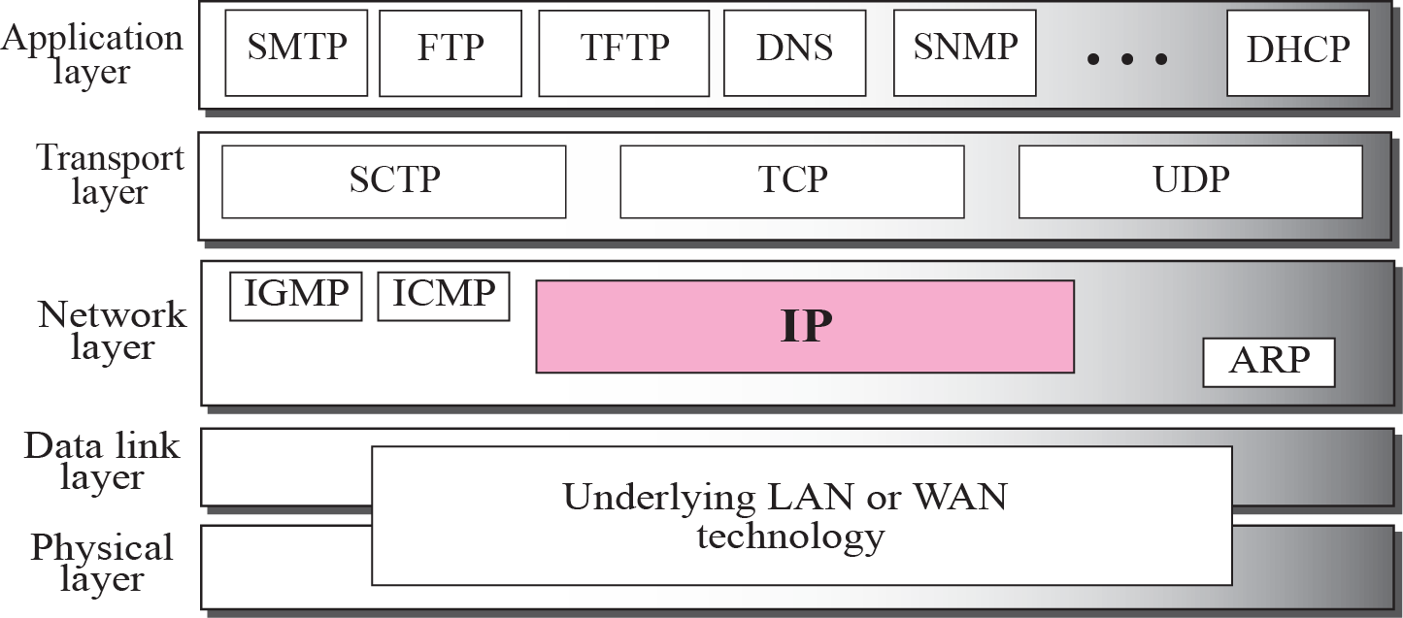
Figure 7.1 Position of IP in TCP/IP protocol suite
TCP/IP Protocol Suite

Slide 5
7-2 DATAGRAMS
Packets in the network (internet) layer are called datagrams. A datagram is a variable-length packet consisting of two parts: header and data. The header is 20 to 60 bytes in length and contains information essential to routing and delivery. It is customary in TCP/IP to show the header in 4-byte sections. A brief description of each field is in order.
TCP/IP Protocol Suite

Slide 6
Topics Discussed in the Section
Format of the datagram packet
Some examples
TCP/IP Protocol Suite

Slide 7
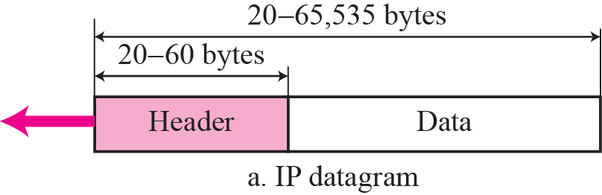
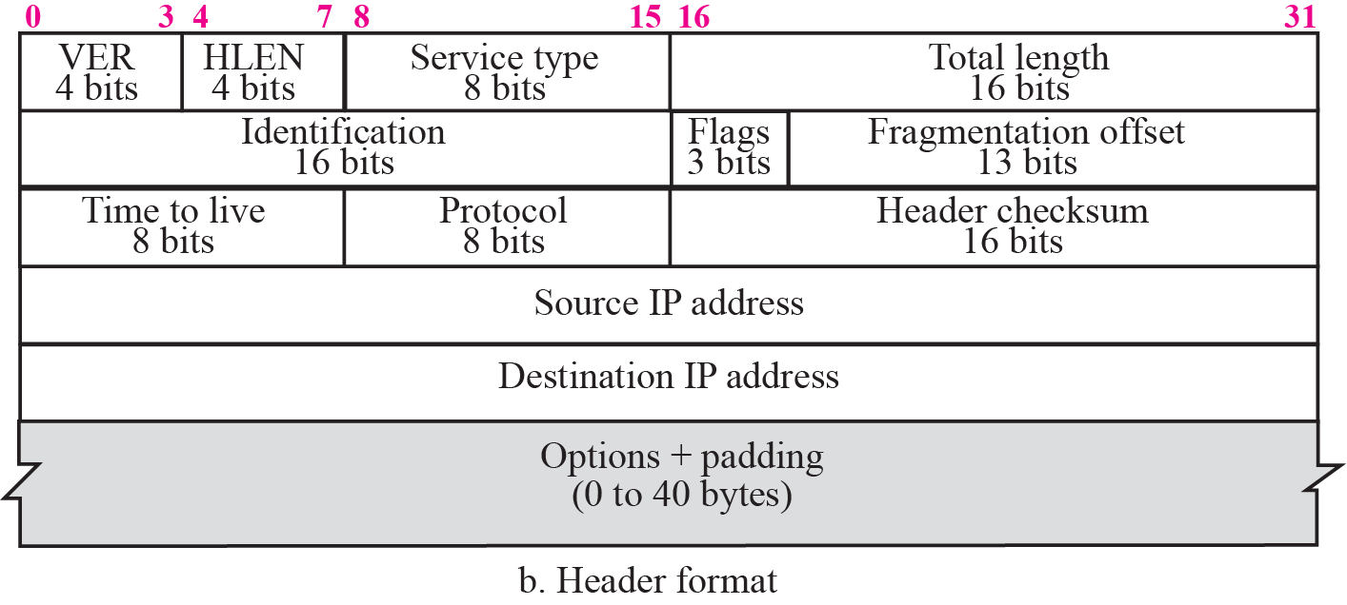
Figure 7.2 IP datagram
TCP/IP Protocol Suite

Slide 8
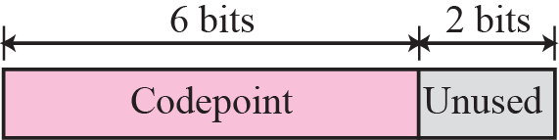
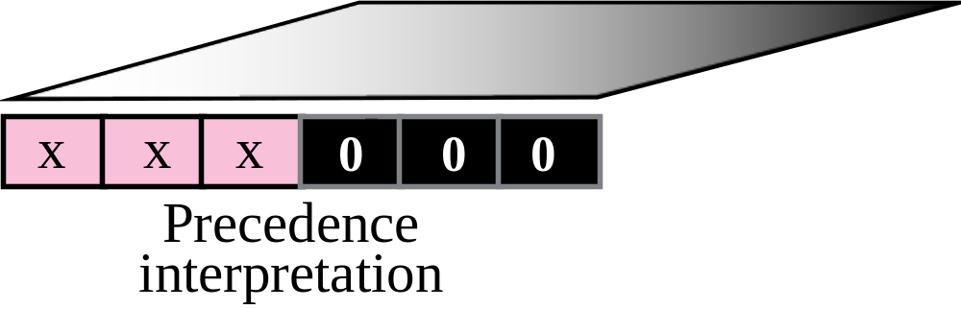
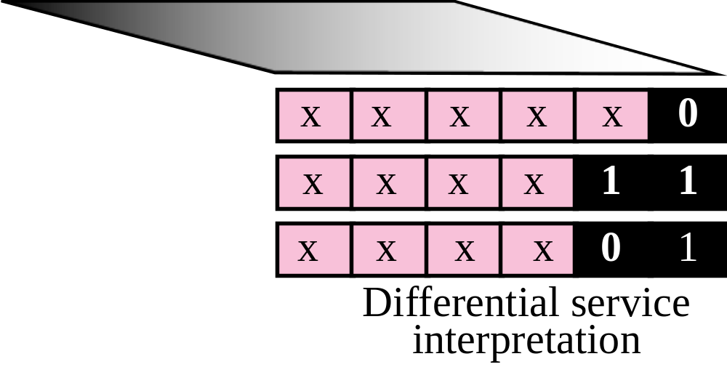
Figure 7.3 Service type
TCP/IP Protocol Suite

Slide 9
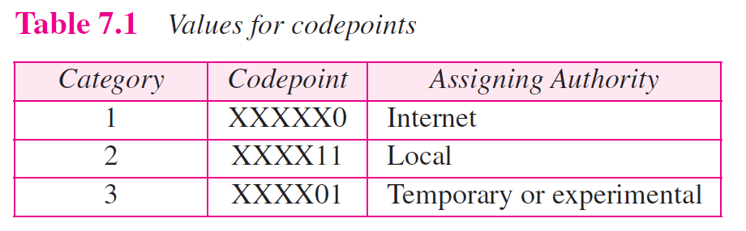
TCP/IP Protocol Suite

Slide 10

Note
The total length field defines the total length of the datagram including the header.
TCP/IP Protocol Suite

Slide 11

Figure 7.4 Encapsulation of a small datagram in an Ethernet frame
TCP/IP Protocol Suite

Slide 12
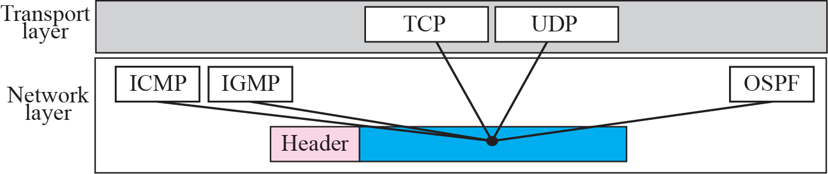
Figure 7.5 Multiplexing
TCP/IP Protocol Suite

Slide 13
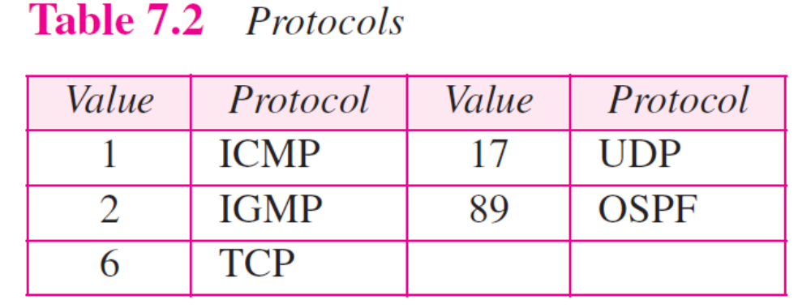
TCP/IP Protocol Suite

Slide 14
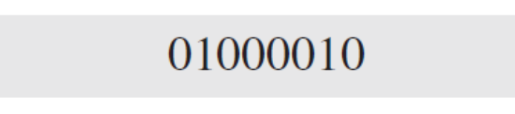
Example 7.1
An IP packet has arrived with the first 8 bits as shown:
The receiver discards the packet. Why?
Solution
There is an error in this packet. The 4 left-most bits (0100) show the version, which is correct. The next 4 bits (0010) show the wrong header length (2 × 4 = 8). The minimum number of bytes in the header must be 20. The packet has been corrupted in transmission.
TCP/IP Protocol Suite

Slide 15
Example 7.2
In an IP packet, the value of HLEN is 1000 in binary. How many bytes of options are being carried by this packet?
Solution
The HLEN value is 8, which means the total number of bytes in the header is 8 × 4 or 32 bytes. The first 20 bytes are the base header, the next 12 bytes are the options.
TCP/IP Protocol Suite

Slide 16
Example 7.3
In an IP packet, the value of HLEN is 5₁₆ and the value of the total length field is 0028₁₆. How many bytes of data are being carried by this packet?
Solution
The HLEN value is 5, which means the total number of bytes in the header is 5 × 4 or 20 bytes (no options). The total length is 40 bytes, which means the packet is carrying 20 bytes of data (40 − 20).
TCP/IP Protocol Suite

Slide 17
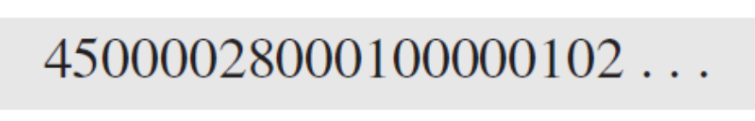
Example 7.4
An IP packet has arrived with the first few hexadecimal digits as shown below:
How many hops can this packet travel before being dropped? The data belong to what upper layer protocol?
Solution
To find the time-to-live field, we skip 8 bytes (16 hexadecimal digits). The time-to-live field is the ninth byte, which is 01. This means the packet can travel only one hop. The protocol field is the next byte (02), which means that the upper layer protocol is IGMP (see Table 7.2)
TCP/IP Protocol Suite

Slide 18
7-3 FRAGMENTATION
A datagram can travel through different networks. Each router decapsulates the IP datagram from the frame it receives, processes it, and then encapsulates it in another frame. The format and size of the received frame depend on the protocol used by the physical network through which the frame has just traveled. The format and size of the sent frame depend on the protocol used by the physical network through which the frame is going to travel.
TCP/IP Protocol Suite

Slide 19
Topics Discussed in the Section
Maximum Transfer Unit (MTU)
Fields Related to Fragmentation
TCP/IP Protocol Suite

Slide 20

Figure 7.6 MTU
TCP/IP Protocol Suite

Slide 21
Note
Only data in a datagram is fragmented.
TCP/IP Protocol Suite

Slide 22

Figure 7.7 Flags field
TCP/IP Protocol Suite

Slide 23
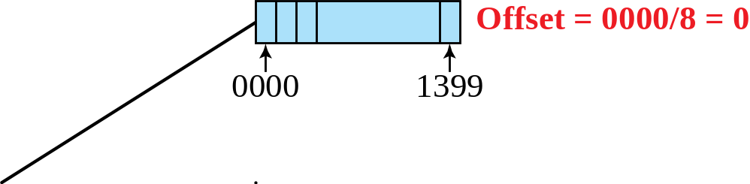
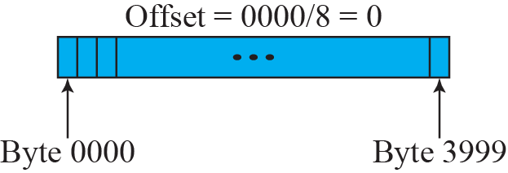
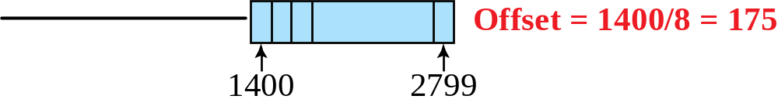
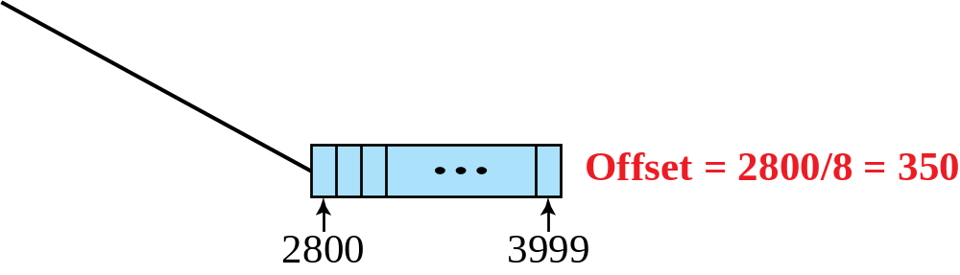
Figure 7.8 Fragmentation example
TCP/IP Protocol Suite

Slide 24
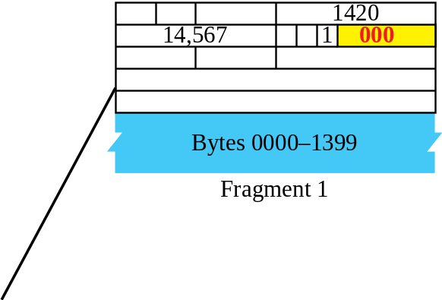
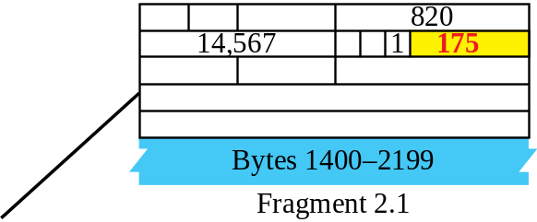
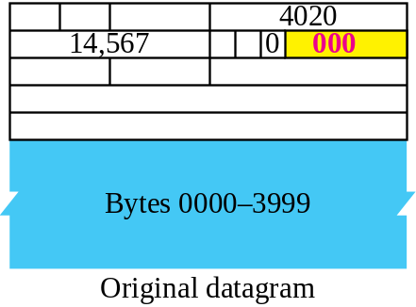
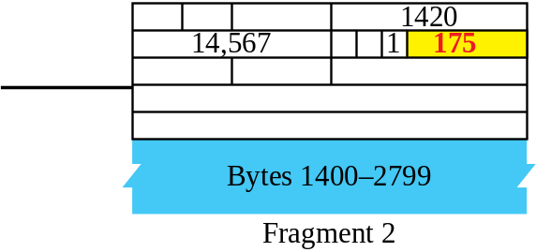
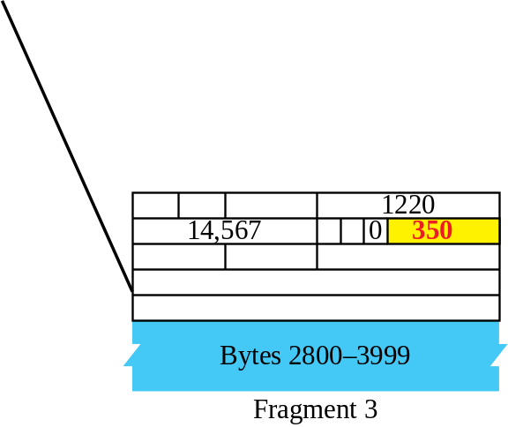
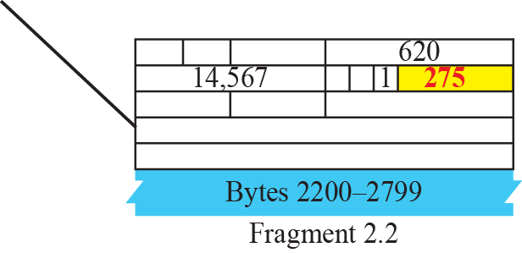
Figure 7.9 Detailed fragmentation example
TCP/IP Protocol Suite

Slide 25
Example 7.5
A packet has arrived with an M bit value of 0. Is this the first fragment, the last fragment, or a middle fragment? Do we know if the packet was fragmented?
Solution
If the M bit is 0, it means that there are no more fragments; the fragment is the last one. However, we cannot say if the original packet was fragmented or not. A nonfragmented packet is considered the last fragment.
TCP/IP Protocol Suite

Slide 26
Example 7.6
A packet has arrived with an M bit value of 1. Is this the first fragment, the last fragment, or a middle fragment? Do we know if the packet was fragmented?
Solution
If the M bit is 1, it means that there is at least one more fragment. This fragment can be the first one or a middle one, but not the last one. We don’t know if it is the first one or a middle one; we need more information (the value of the fragmentation offset). See also the next example.
TCP/IP Protocol Suite

Slide 27
Example 7.7
A packet has arrived with an M bit value of 1 and a fragmentation offset value of zero. Is this the first fragment, the last fragment, or a middle fragment?
Solution
Because the M bit is 1, it is either the first fragment or a middle one. Because the offset value is 0, it is the first fragment.
TCP/IP Protocol Suite

Slide 28
Example 7.8
A packet has arrived in which the offset value is 100. What is the number of the first byte? Do we know the number of the last byte?
Solution
To find the number of the first byte, we multiply the offset value by 8. This means that the first byte number is 800. We cannot determine the number of the last byte unless we know the length of the data.
TCP/IP Protocol Suite

Slide 29
Example 7.9
A packet has arrived in which the offset value is 100, the value of HLEN is 5 and the value of the total length field is 100. What is the number of the first byte and the last byte?
Solution
The first byte number is 100 × 8 = 800. The total length is 100 bytes and the header length is 20 bytes (5 × 4), which means that there are 80 bytes in this datagram. If the first byte number is 800, the last byte number must be 879.
TCP/IP Protocol Suite

Slide 30
7-4 OPTIONS
The header of the IP datagram is made of two parts: a fixed part and a variable part. The fixed part is 20 bytes long and was discussed in the previous section. The variable part comprises the options, which can be a maximum of 40 bytes.
Options, as the name implies, are not required for a datagram. They can be used for network testing and debugging. Although options are not a required part of the IP header, option processing is required of the IP software.
TCP/IP Protocol Suite

Slide 31
Topics Discussed in the Section
Format
Option Types
TCP/IP Protocol Suite

Slide 32
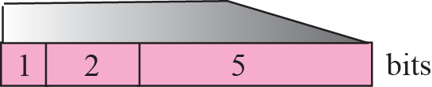
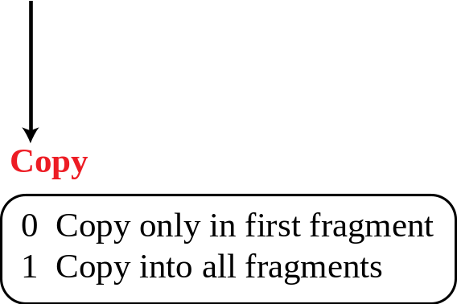
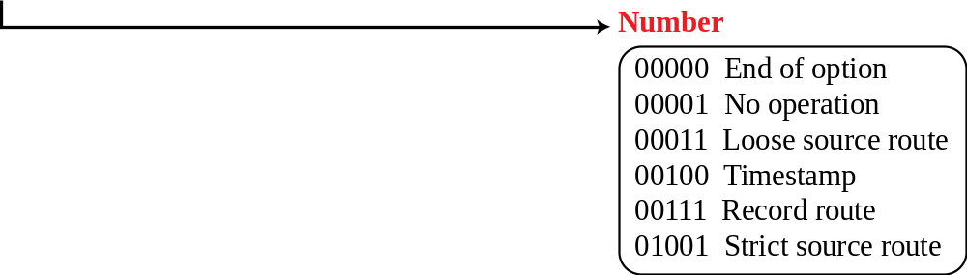
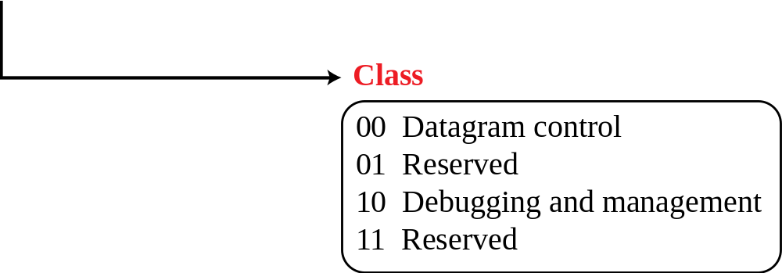
Figure 7.10 Option format
TCP/IP Protocol Suite

Slide 33
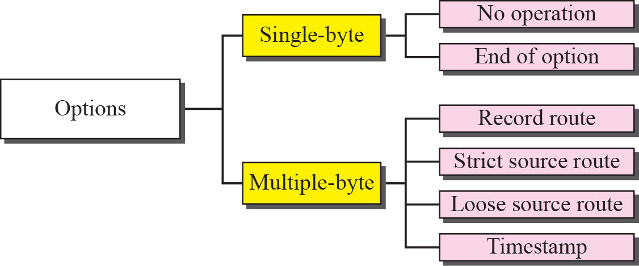
Figure 7.11 Categories of options
TCP/IP Protocol Suite

Slide 34
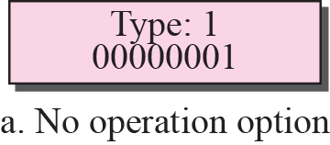
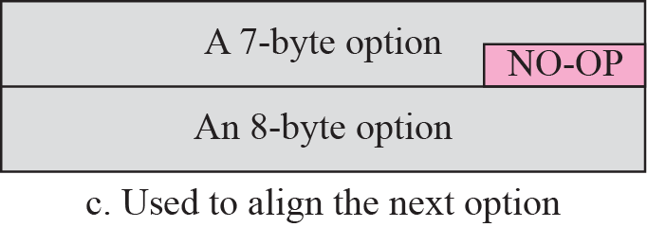
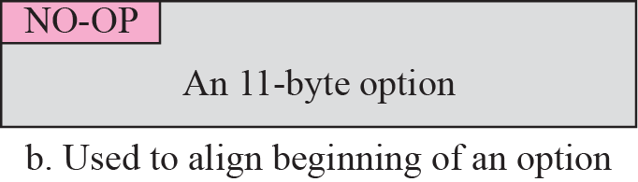
Figure 7.12 No operation option
TCP/IP Protocol Suite

Slide 35
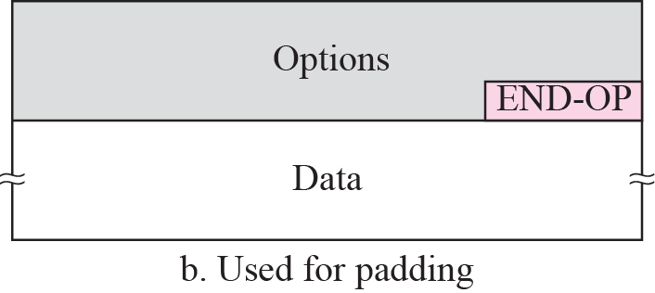
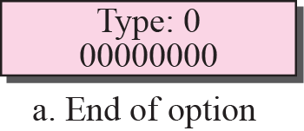
Figure 7.13 Endo-of-option option
TCP/IP Protocol Suite

Slide 36
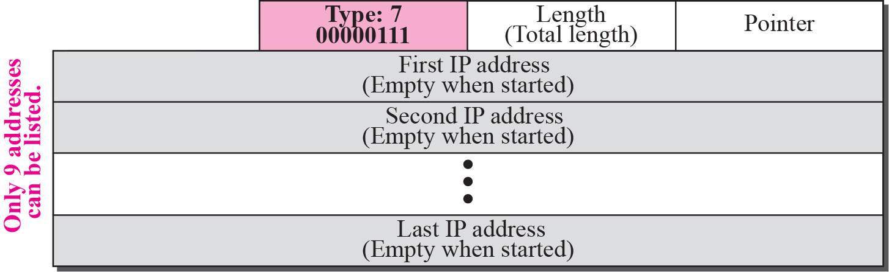
Figure 7.14 Record-route option
TCP/IP Protocol Suite

Slide 37
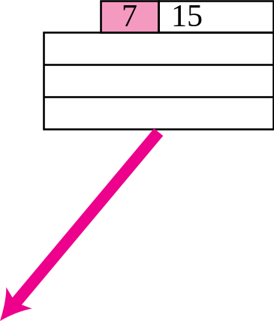
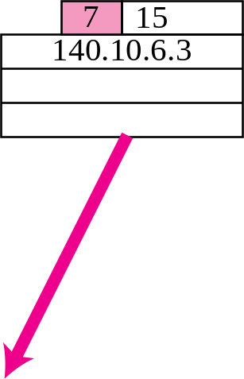
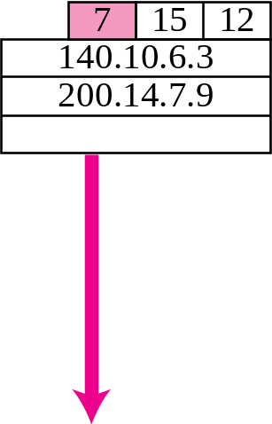
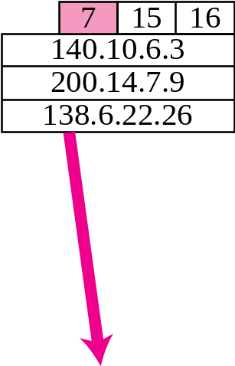
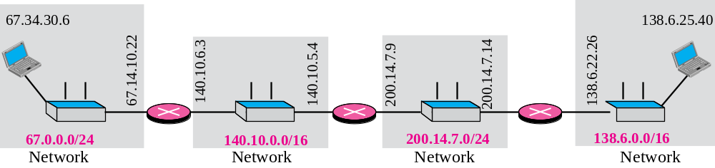
Figure 7.15 Record-route concept
4
8
TCP/IP Protocol Suite

Slide 38
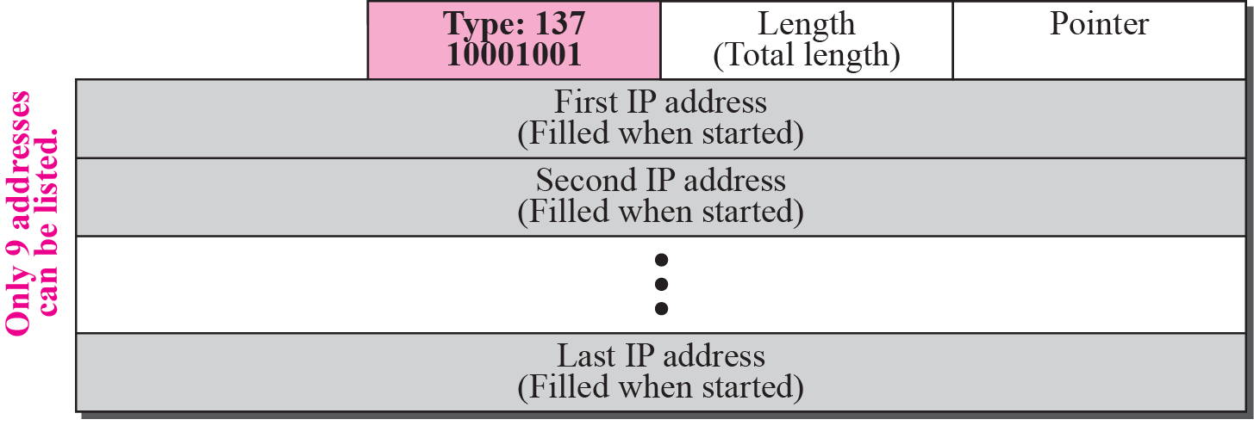
Figure 7.16 Strict-source-route option
TCP/IP Protocol Suite

Slide 39
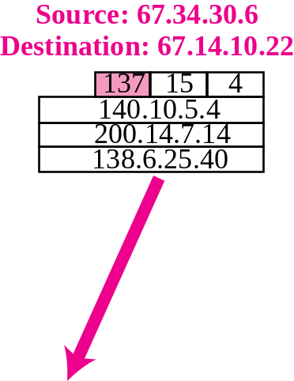
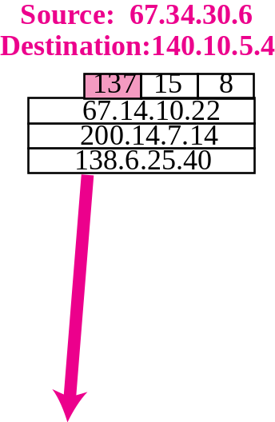
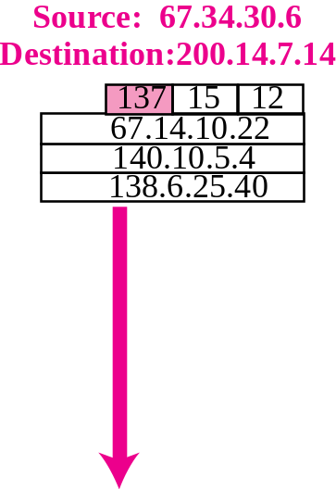
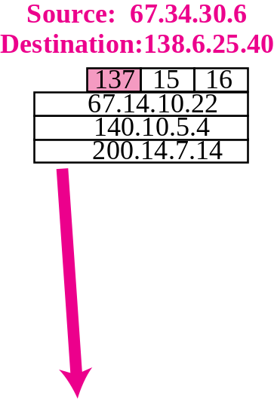
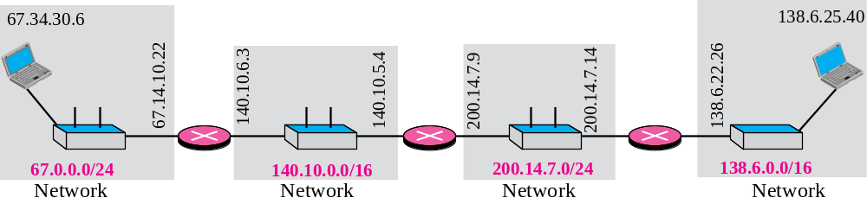
Figure 7.17 Strict-source-route option
TCP/IP Protocol Suite

Slide 40
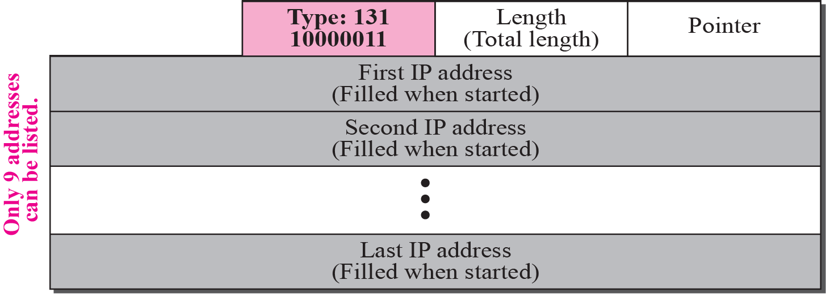
Figure 7.18 Loose-source-route option
TCP/IP Protocol Suite

Slide 41
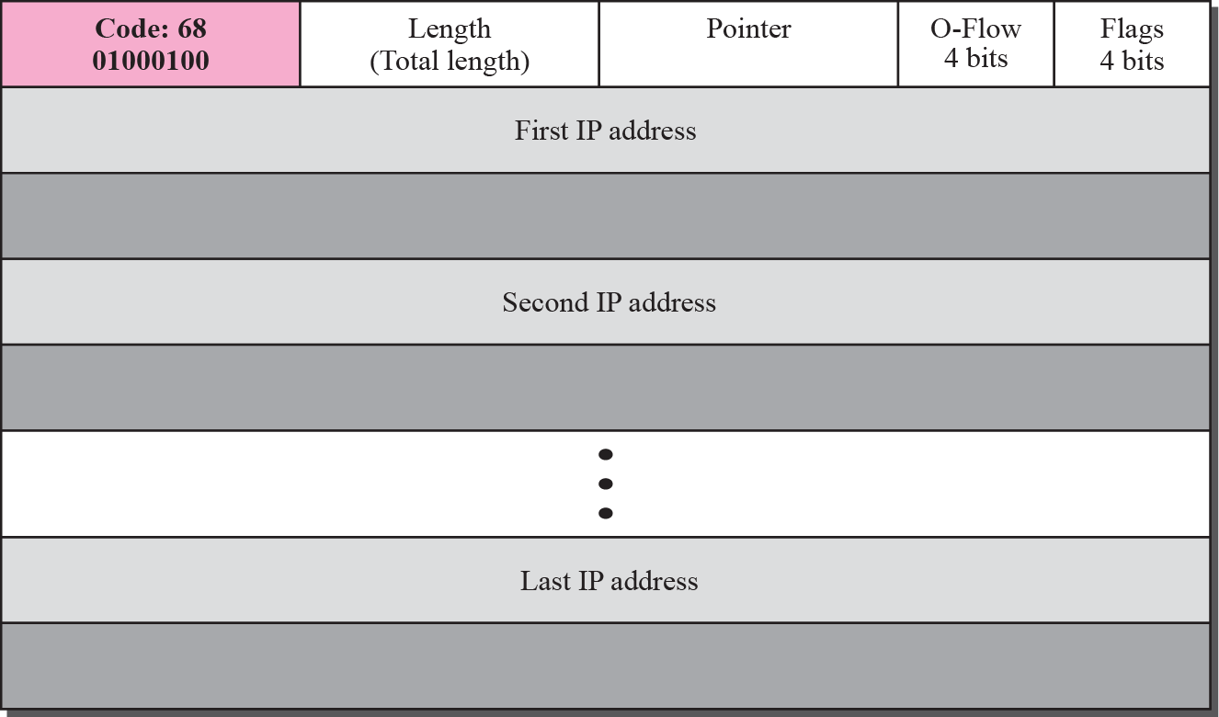
Figure 7.19 Time-stamp option
TCP/IP Protocol Suite

Slide 42
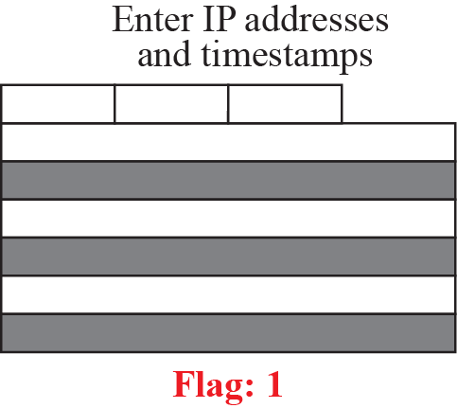
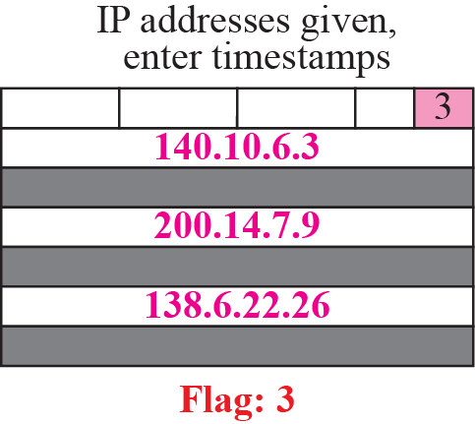
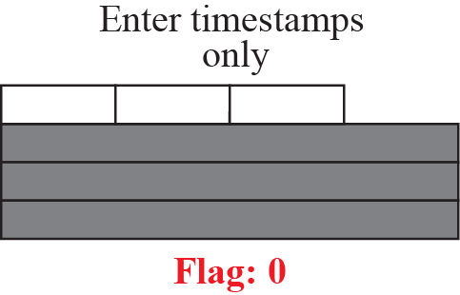
Figure 7.20 Use of flags in timestamp
TCP/IP Protocol Suite

Slide 43
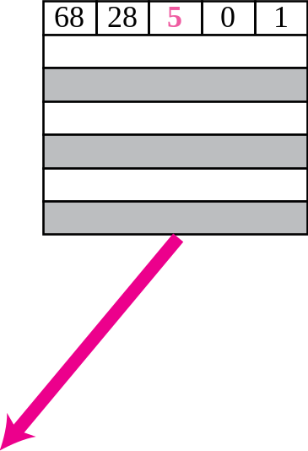
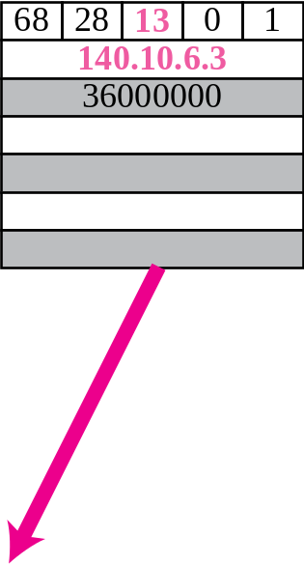



Figure 7.21 Timestamp concept
TCP/IP Protocol Suite

Slide 44
Example 7.10
Which of the six options must be copied to each fragment?
Solution
We look at the first (left-most) bit of the type for each option.
a. No operation: type is 00000001; not copied.
b. End of option: type is 00000000; not copied.
c. Record route: type is 00000111; not copied.
d. Strict source route: type is 10001001; copied.
e. Loose source route: type is 10000011; copied.
f. Timestamp: type is 01000100; not copied.
TCP/IP Protocol Suite

Slide 45
Example 7.11
Which of the six options are used for datagram control and which
for debugging and managements?
Solution
We look at the second and third (left-most) bits of the type.
a. No operation: type is 00000001; datagram control.
b. End of option: type is 00000000; datagram control.
c. Record route: type is 00000111; datagram control.
d. Strict source route: type is 10001001; datagram control.
e. Loose source route: type is 10000011; datagram control.
f. Timestamp: type is 01000100; debugging and management
control.
TCP/IP Protocol Suite

Slide 46

Example 7.12
One of the utilities available in UNIX to check the traveling of the IP packets is ping. In the next chapter, we talk about the ping program in more detail. In this example, we want to show how to use the program to see if a host is available. We ping a server at De Anza College named fhda.edu. The result shows that the IP address of the host is 153.18.8.1. The result also shows the number of bytes used.
TCP/IP Protocol Suite

Slide 47

Example 7.13
We can also use the ping utility with the -R option to implement the record route option. The result shows the interfaces and IP addresses.
TCP/IP Protocol Suite

Slide 48

Example 7.14
The traceroute utility can also be used to keep track of the route of a packet. The result shows the three routers visited.
TCP/IP Protocol Suite

Slide 49

Example 7.15
The traceroute program can be used to implement loose source routing. The -g option allows us to define the routers to be visited, from the source to destination. The following shows how we can send a packet to the fhda.edu server with the requirement that the packet visit the router 153.18.251.4.
TCP/IP Protocol Suite

Slide 50

Example 7.16
The traceroute program can also be used to implement strict source routing. The -G option forces the packet to visit the routers defined in the command line. The following shows how we can send a packet to the fhda.edu server and force the packet to visit only the router 153.18.251.4.
TCP/IP Protocol Suite

Slide 51
7-5 CHECKSUM
The error detection method used by most TCP/IP protocols is called the checksum. The checksum protects against the corruption that may occur during the transmission of a packet. It is redundant information added to the packet. The checksum is calculated at the sender and the value obtained is sent with the packet. The receiver repeats the same calculation on the whole packet including the checksum. If the result is satisfactory (see below), the packet is accepted; otherwise, it is rejected.
TCP/IP Protocol Suite

Slide 52
Topics Discussed in the Section
Checksum Calculation at the Sender
Checksum Calculation at the Receiver
Checksum in the Packet
TCP/IP Protocol Suite

Slide 53




Figure 7.22 Checksum concept
TCP/IP Protocol Suite

Slide 54



Figure 7.23 Checksum in one’s complement arithmetic
TCP/IP Protocol Suite

Slide 55
Note
Checksum in IP covers only the header, not the data.
TCP/IP Protocol Suite

Slide 56
Example 7.17
Figure 7.24 shows an example of a checksum calculation at the sender site for an IP header without options. The header is divided into 16-bit sections. All the sections are added and the sum is complemented. The result is inserted in the checksum field.
TCP/IP Protocol Suite

Slide 57


Figure 7.24 Example of checksum calculation at the sender
TCP/IP Protocol Suite
Notes:
Substitute for 012.6.7.917015010.12.14.50028Substitute for 012.6.7.917015010.12.14.50028Substitute for 0Substitute for 0

Slide 58
Example 7.18
Figure 7.25 shows the checking of checksum calculation at the receiver site (or intermediate router) assuming that no errors occurred in the header. The header is divided into 16-bit sections. All the sections are added and the sum is complemented. Since the result is 16 0s, the packet is accepted.
TCP/IP Protocol Suite

Slide 59


Figure 7.25 Example of checksum calculation at the receiver
TCP/IP Protocol Suite

Slide 60
Note
Appendix D gives an algorithm for checksum calculation.
TCP/IP Protocol Suite

